Slide 1
FRIXEL
noun
Frame x Pixel
A finite element analysis program that’s so easy
a 5 year old could use it.
Emil Poulsen CORE Studio @ Thornton Tomasetti
Leland Jobson CORE Studio @ Thornton Tomasetti

Slide 2
Goal
To bring analysis to the immediacy of sketching.
Function & Benefits
A power-up for architect-engineer collaboration.
A great way to test and guide options in early stage design.
Fast. You can quickly get an understanding of structural behavior.

Slide 3
Stack
GeneticSharp (Genetic algorithm library) +
FESharp (FEA library for C#) +
WPF (Windows native UI)
Notes
Platform agnostic, prototype for Rhino
Auto-designs structural topology
Auto-optimizes for minimal displacement

Slide 4
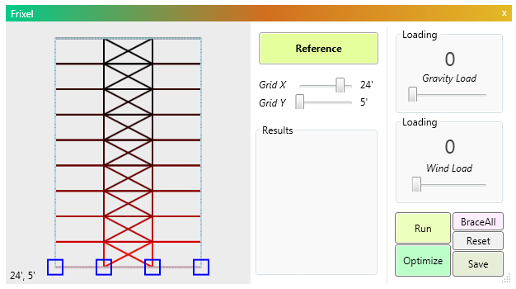
1. Reference a shape
2. Apply loads
3. See if something
goes wrong
4. Optimize the design

Slide 8

github.com/EmilPoulsen/frixel

Slide 9
